Slide 1
Image classification of UD sculptures
Narendar Nagilla
Bharadwaj Vennam

Slide 2
Introduction
Image classification is the process of teaching a machine to recognize images and classify them into one of the trained categories.
In this project we will predict the sculpture which is shown on mobile camera and it will display short video of the sculpture.
Our project will display short video of omega point as we chose “Omega point” as our sculpture.

Slide 3
Project description and Purpose
The main aim of the image classification is to recognize the sculpture and give some historical information about the sculpture.
The purpose of the project is to make the mobile recognize the sculpture after a specified training.
Our project is designed for omega point.

Slide 4
Source of data
A data set folder is created with 24 sub-folders in train and validation.
Each subdirectory is named after the category(sculpture) and contains only photographs of that sculpture.
We collected images of Omega point with a camera in different angles.
Omega point consist of 90 images for train and 10 images for validation.

Slide 5
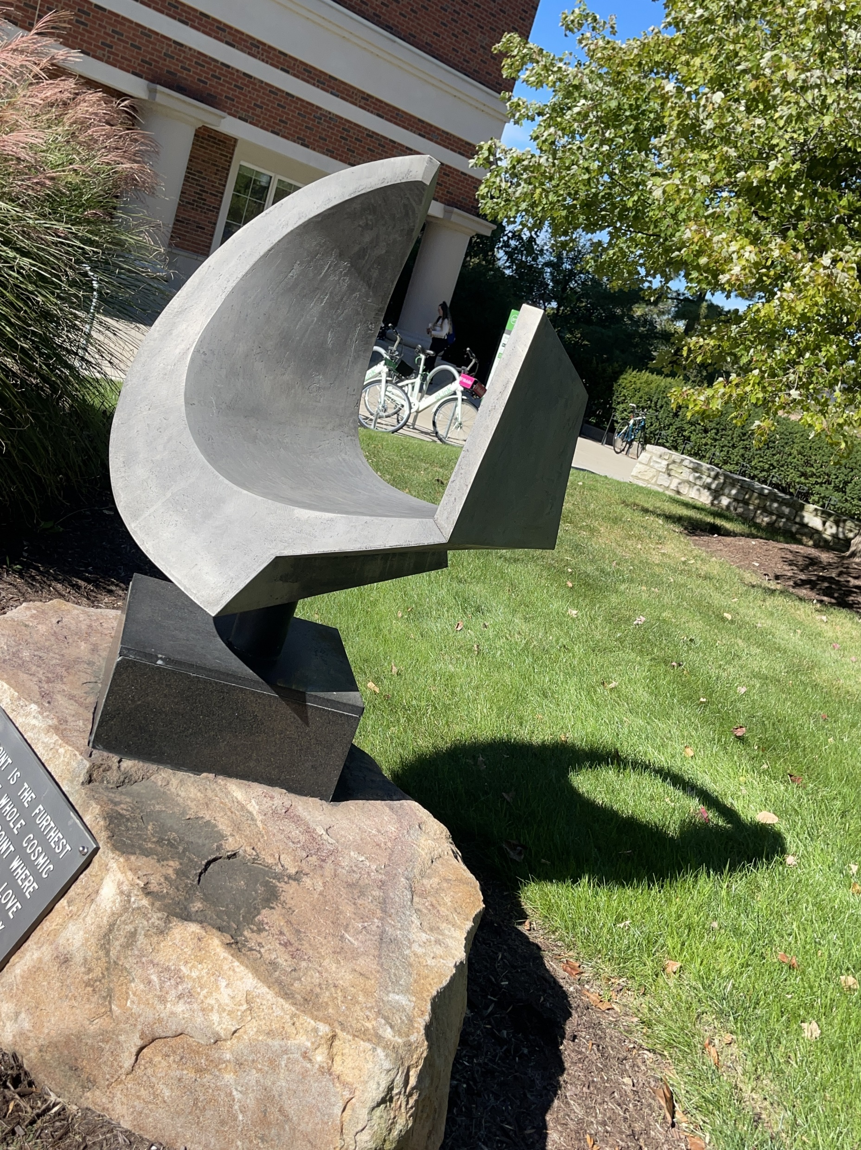
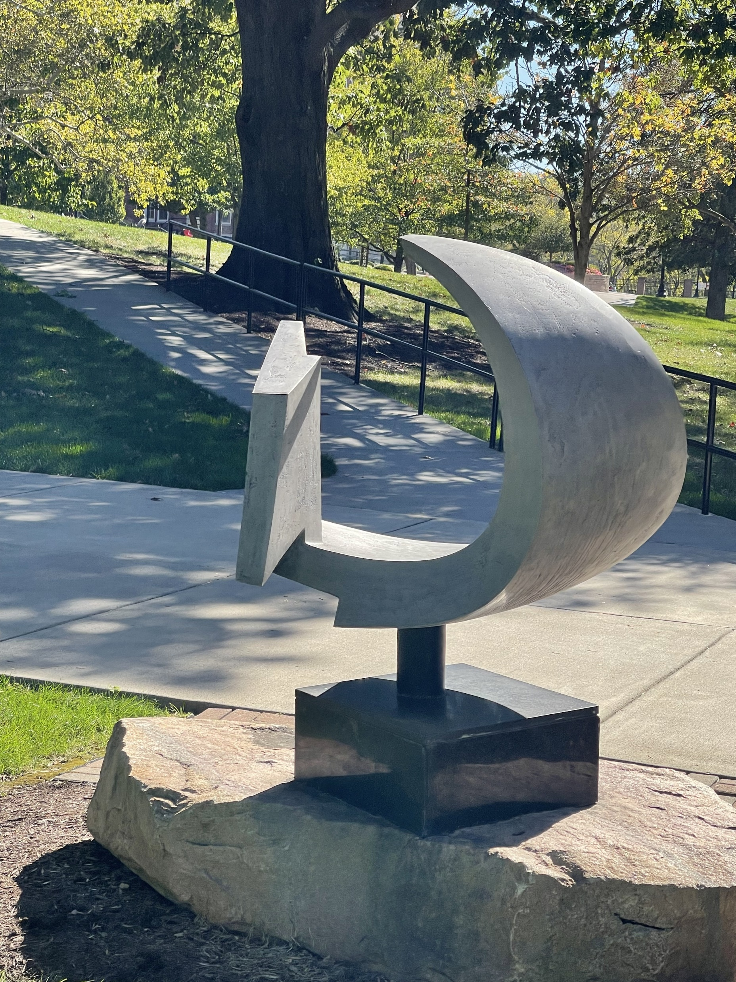
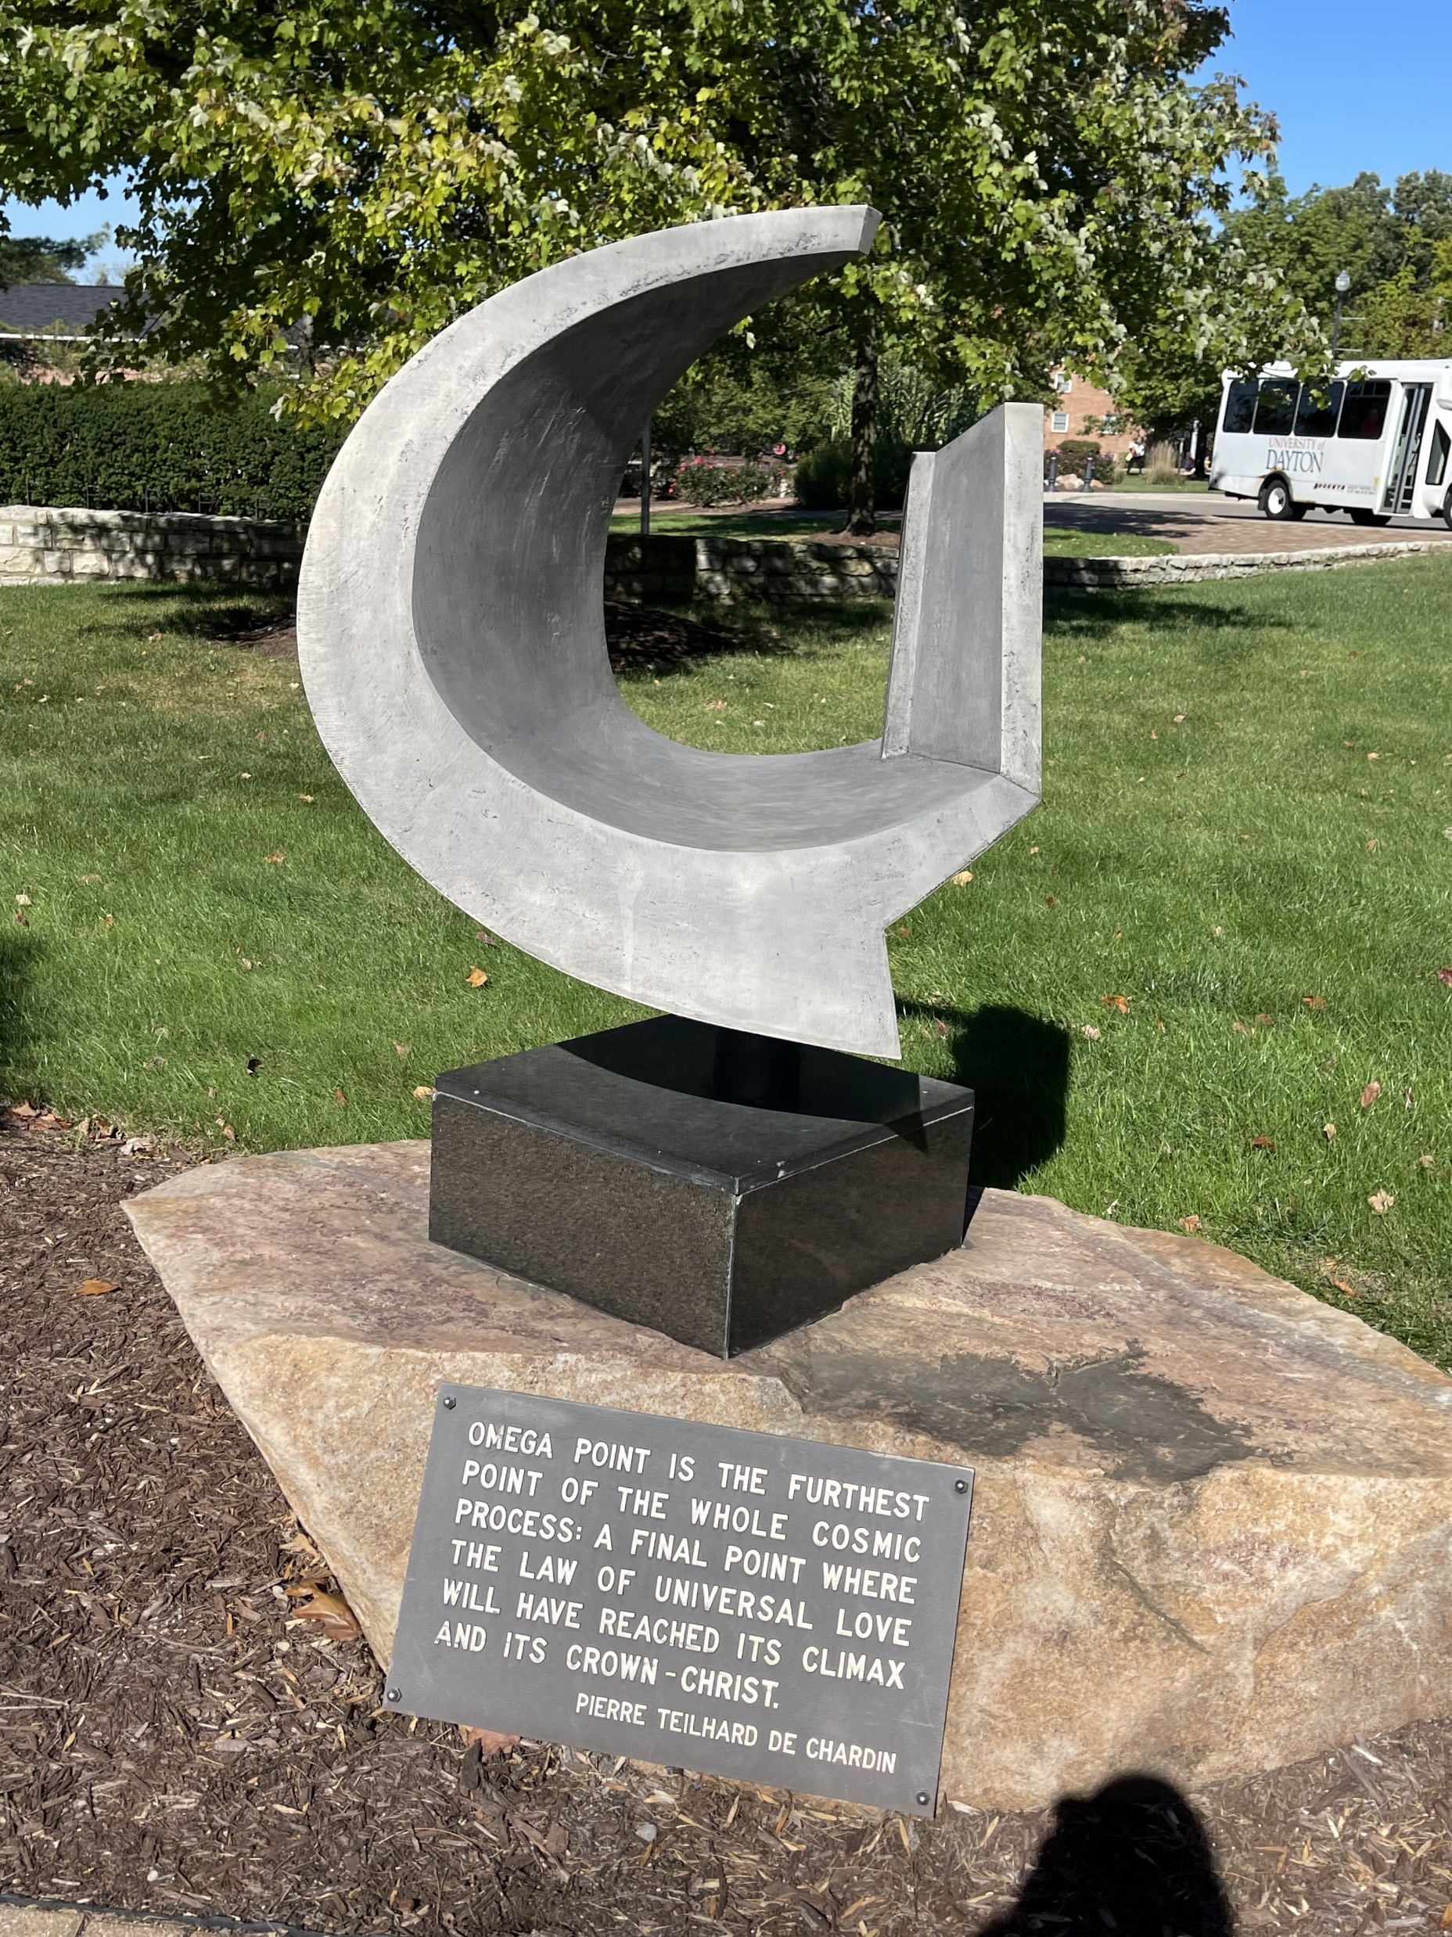
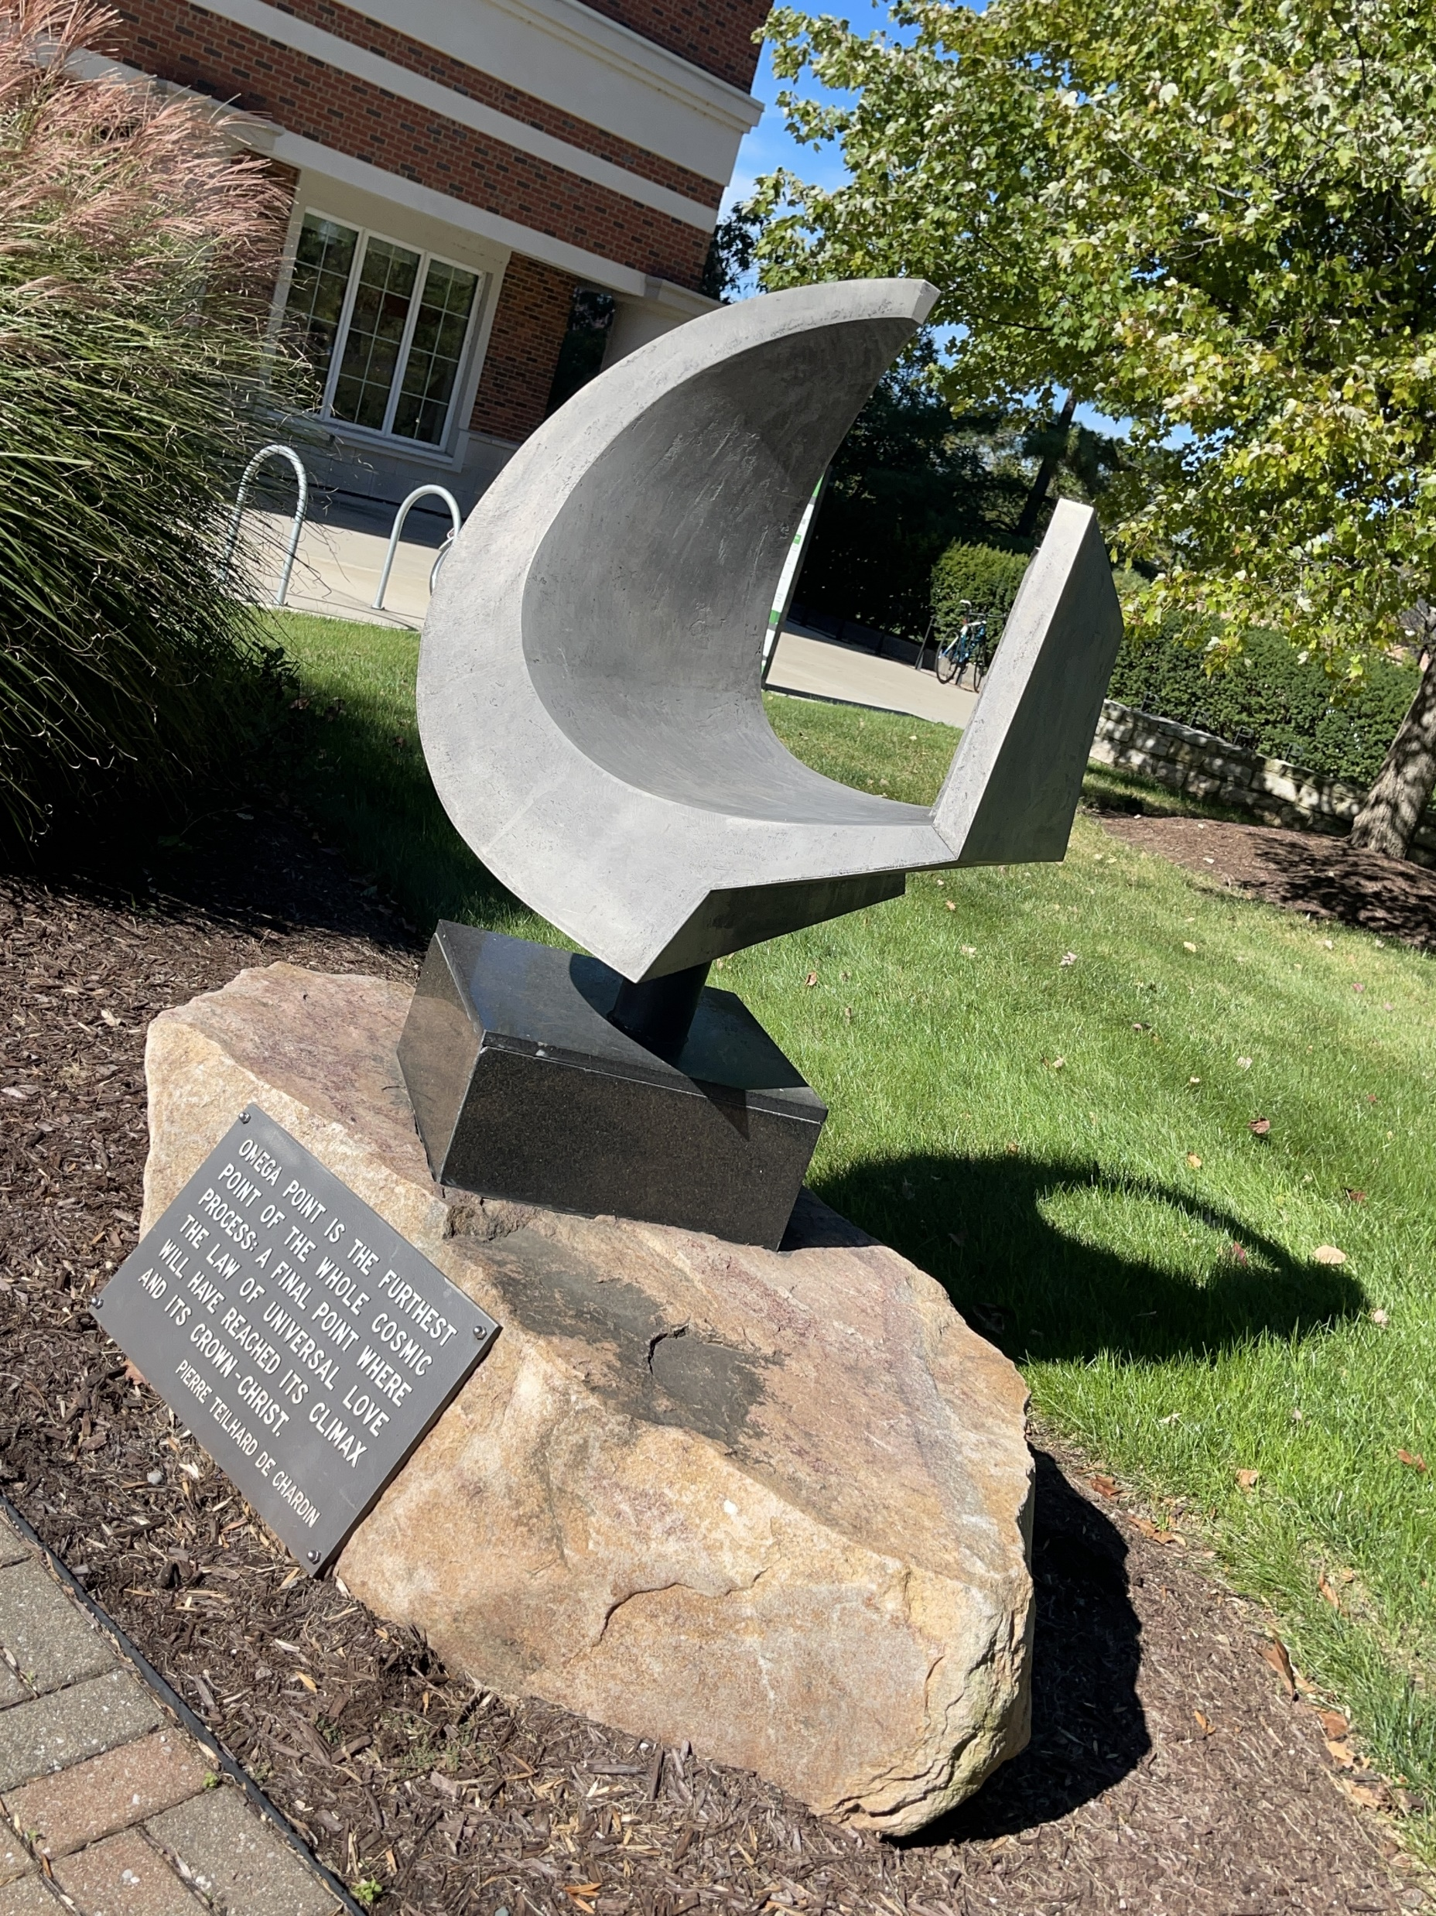
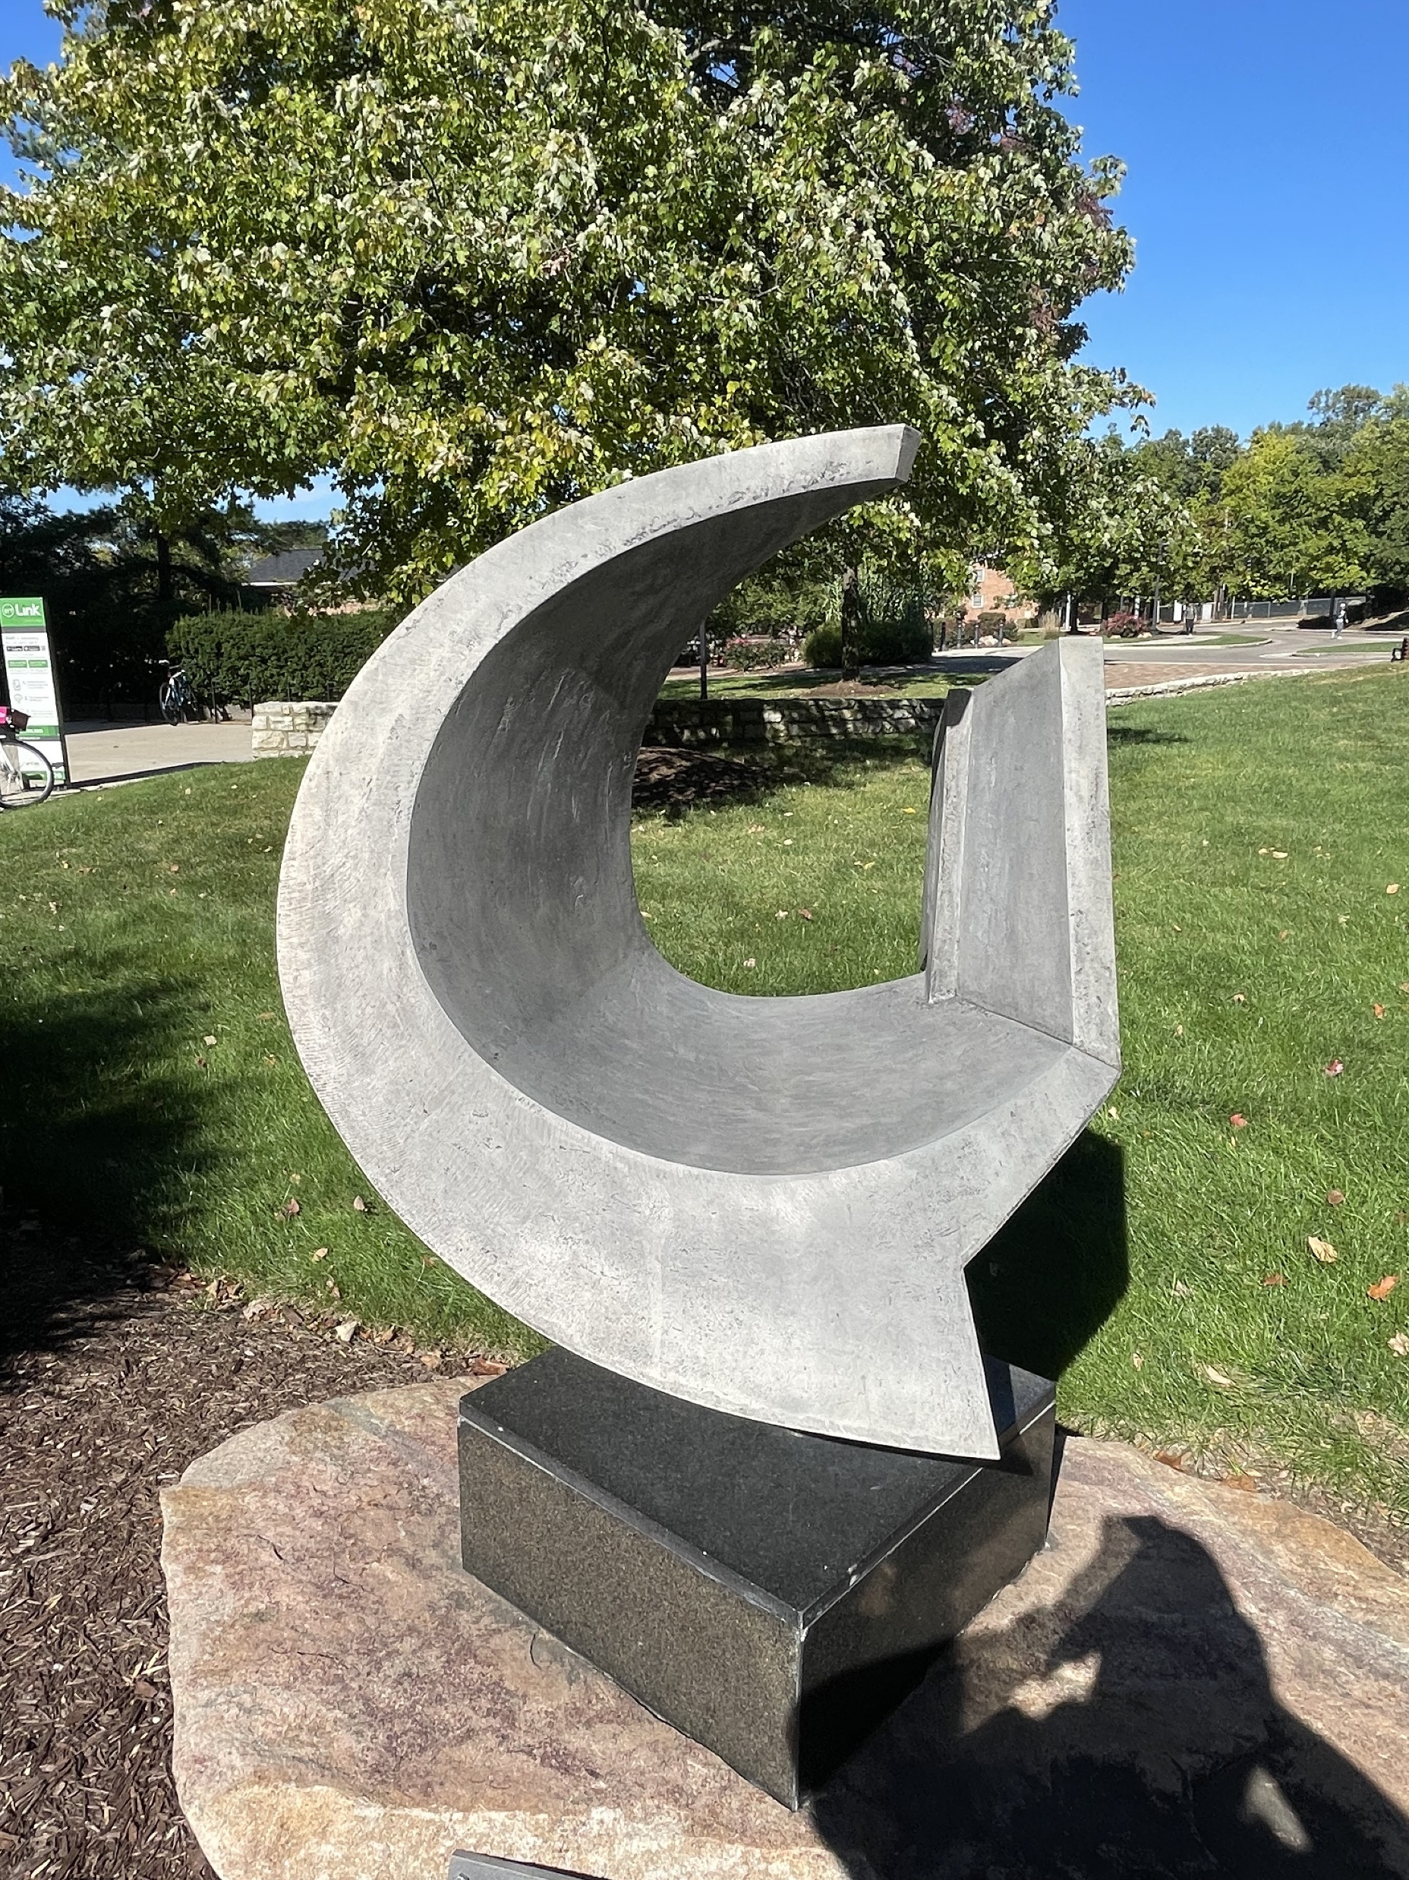
Sample Images

Slide 6
Details of Implementation
Initially we have collected the data (images) for training(3615 images) and validation(385 images)
Imported all the necessary library for the project TensorFlow, pandas and NumPy.
By using image data generator we rescale the image (1.0/255) and horizontal flip of the image
For extracting all the image from the directory we have used flow_from_directory

Slide 7
Image Data Generator
It’s a class in keras used for implementing image augmentation.
It can generate augmented image dynamically during the training of model making overall mode more robust and accurate.
Image augmentation- It’s a way of applying transformation techniques on actual images.
Random rotations
Random shifts
Random flips
Random Brightness
Random zoom

Slide 8
Details of Implementation
For predicting the sculpture we have used a imported pretrained model which id efficient net lite.
Model is compiled with an optimizer (ADAM).
We trained the model with 5 epochs and obtained an accuracy around 95% to 98%.
We converted the model into .tflite file then we converted into .ONNX file to deploy it into unity.
We built GUI on unity and placed .ONNX file, labels, video with the required mappings
We deployed unity app on iPhone with XCode in the form of IOS application

Slide 9
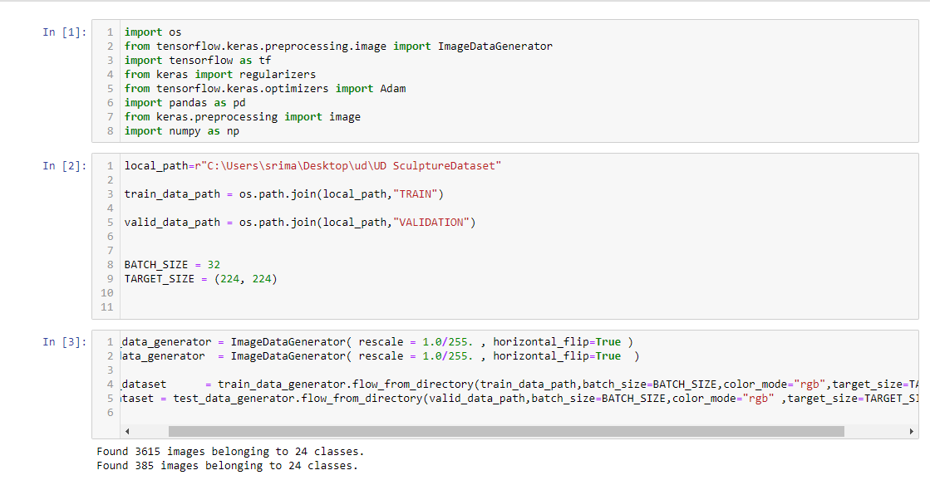
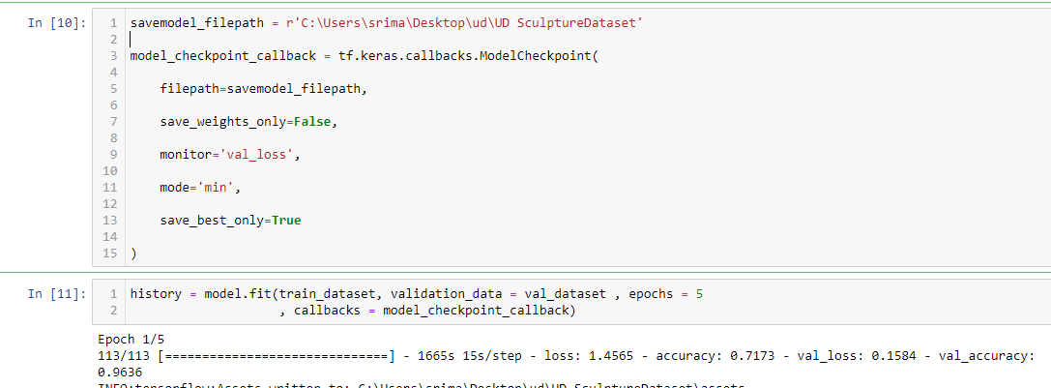
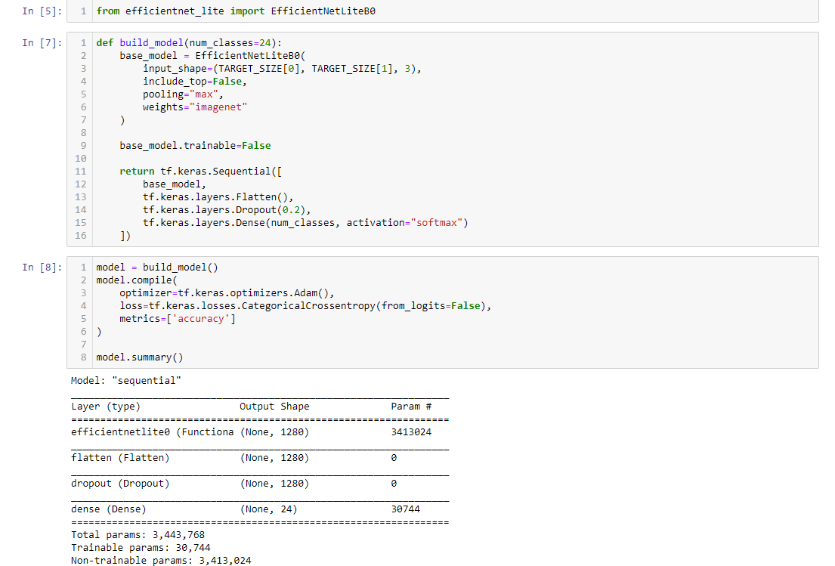
CODE

Slide 10

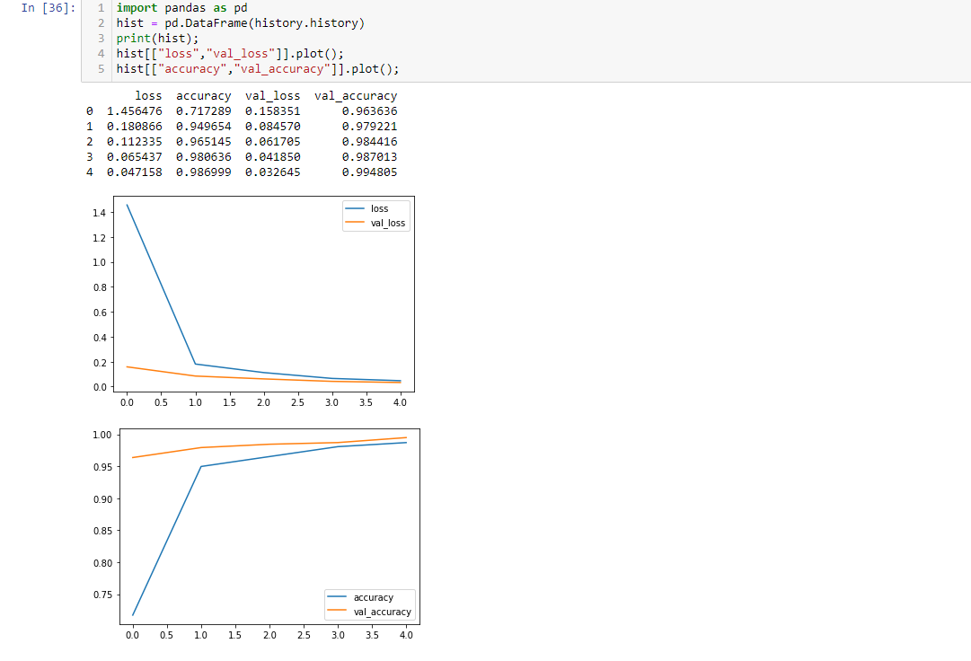
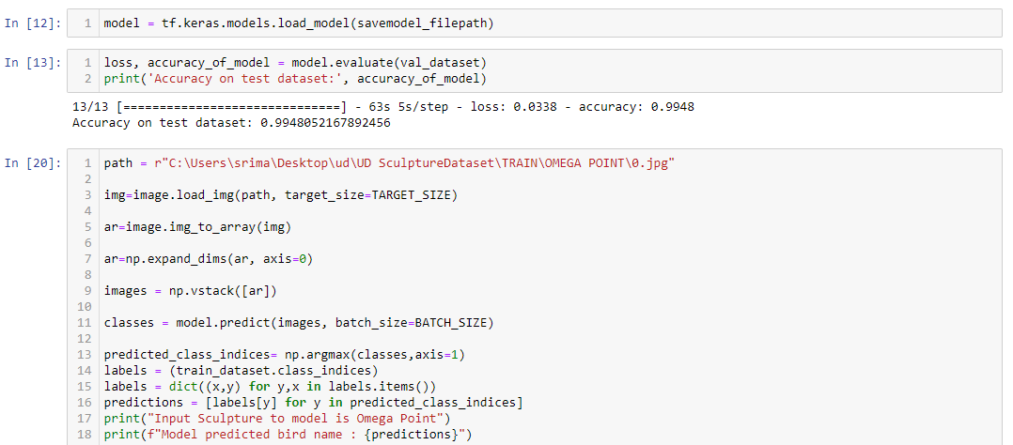
CODE

Slide 11
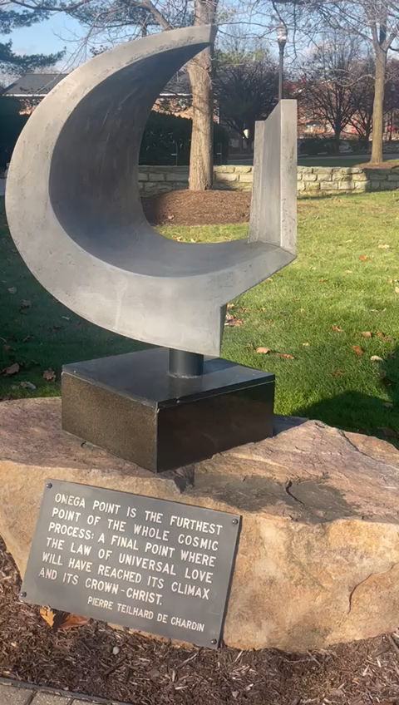
AR video

Slide 12
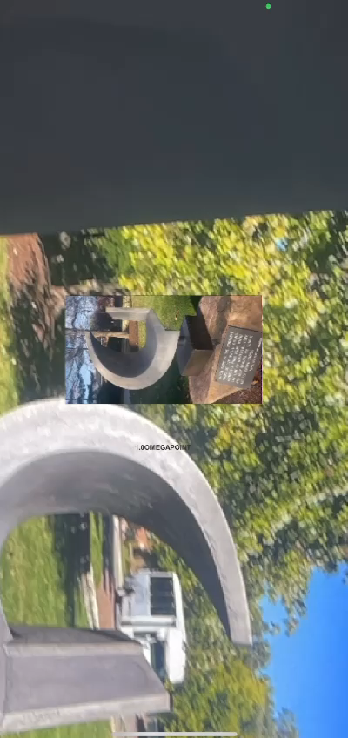
Result

Slide 13
Conclusion
We accurately predicted the sculpture and displayed a short video about the sculpture

Slide 14
Thank you

